Slide 1
^{LESSON 9: JULY 28}

Slide 2
Expectant Watchfulness
Focus Scripture: Psalm 130
Key Verse: O Israel, hope in the Lord! For with the Lord there is steadfast love, and with him is great power to redeem. Psalm 130:7
(NRSV UE)

Slide 3
Psalm 130 (NRSV UE)
1 Out of the depths I cry to you, O Lord.
2 Lord, hear my voice! Let your ears be attentive to the voice of my supplications!
3 If you, O Lord, should mark iniquities, Lord, who could stand?
4 But there is forgiveness with you, so that you may be revered.
5 I wait for the Lord; my soul waits, and in his word I hope;
6 my soul waits for the Lord more than those who watch for the morning, more than those who watch for the morning.
7 O Israel, hope in the Lord! For with the Lord there is steadfast love, and with him is great power to redeem.
8 It is he who will redeem Israel from all its iniquities.

Slide 4
^{Key Terms}
Kidron (Kid-ron) – A ravine or wadi east of Jerusalem.
Psalter (Sawl-ter) – “The Psalms,” a collection of psalms for liturgical or devotional use.
Sheol (Hebrew) – The house or realm of the dead.
Your title here

Slide 6
People are often their own worst enemies. What are ways to address the enemy that is “us”? Our lesson passage for today, Psalm 130, reminds us that our sins may drag us down, but the Lord’s power to redeem us will set us on our feet again.

Slide 8
Psalm 130 is a part of a group of psalms in the psalter know as Psalms of Ascent or Pilgrim Psalms (Psalms 120-134). They represent praise and prayer on the move. They would have been songs used by the pilgrims making their sojourn and entering the temple at Jerusalem in the period following the Babylonian exile.
A wonderful serenity has taken possession

Slide 10
Leymah Gbowee is a Liberian peace activist. She is a recipient of the Nobel Peace Prize for her non-violent struggle for the safety of women and for women’s rights to full participation in peace-building work. In 1990, civil war broke out in Liberia. Leymah Gbowee underwent training in trauma therapy in order to take care of traumatized child soldiers. In 2002, she organized the grass roots movement, Women of Liberia Mass Action for Peace, which held meetings at which Christian and Muslim women jointly presented a non-violent message of peace.
A wonderful serenity has taken possession

Slide 12
Psalm 130 and the story of Leymah Gbowee highlight the power and necessity to wait as well as the very important questions: How do we wait? What does waiting look like? How do we know what shape our faithful waiting should take? Spiritual discernment can help us figure out how we are called to wait.

Slide 13
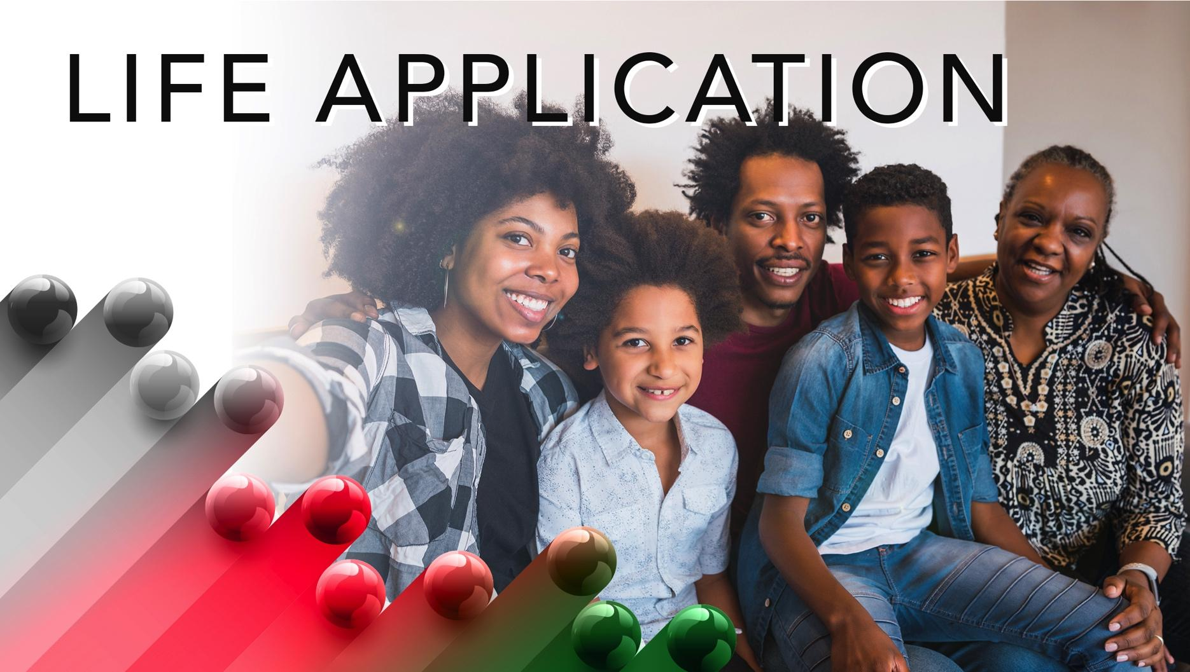

Slide 14
The only thing that exceeds human sinfulness is God’s love and forgiveness. This is good news! Psalm 130, a psalm of ascent, reminds us that we can cry out in our current circumstances in honesty and contrition with the blessed assurance that God hears and forgives, not even keeping a record of our wrongdoing.

Slide 16
1. Have you ever lost sleep anticipating the next day’s events? Did it turn out like you hoped?

Slide 17
2. Have you been waiting for something a long time? Why don’t you give up? How long will you wait? Is there anything that can stop your waiting?

Slide 19
Closing Song: “Blessed Assurance, Jesus Is Mine” (AMEC Hymnal #450)
Closing Prayer: I wait for you patiently and eagerly, loving and forgiving God. We put our hope solely in you. We wait because we believe. We wait and pray, in the name of Jesus. Amen.

